Slide 1


CERT Organization
CERT Core Class
997 Cedar
8 June 2023
Bill Springer and Steve Greenberg
Version: 05 June 2023
Notes:
You’re here because you want to help your neighbors after a disaster.
Ask what classes have been taken and how many want caches?

Slide 2

Core CERT Classes (CERT Basic Training)
Unit 1: Disaster Preparedness
Unit 2: CERT Organization
Units 3 and 4: Disaster Medical Operations 1 and 2 (cache req’t)
Unit 5: Disaster Psychology
Unit 6: Fire Safety and Utility Control (cache req’t)
Unit 7: Light Search and Rescue (cache req’t)
Unit 8: Terrorism and CERT

Slide 3
Neighborhood Organization
A group of neighbors can organize to help themselves in a disaster (and other times)
To be efficient and effective, the group needs to have training to know how to best proceed
There is an existing methodology that is proven to work and is used by first responders such as the fire department
It is the Incident Command System (ICS) and can be used by a neighborhood CERT

Slide 4
What is the Incident Command System (ICS)?
Systematic tool used for the command, control and coordination of emergency response.
Fully scalable (small to large to small)
Uses a common terminology
Notes:
ICS was originally developed in the 1970s during massive wildfire suppression efforts in California and following a series of catastrophic wildfires in California's urban interface. Property damage ran into the millions, and many people died or were injured. Studies determined that response problems often related to communication and management deficiencies rather than lack of resources or failure of tactics. ICS is a fully scalable system of organizing funds, personnel, facilities, equipment, and communications. It can start small, grow and then contract as the incident warrants. Expanded by State of Cal into Standard Emergency Management System, then FEMA adopted SEMS and renamed it the National Incident Management System or NIMS. (Also SEMS)

Slide 5
Why CERT?
1985 Mexico City earthquake: 100 civilians were killed trying to assist rescue efforts
The need for training civilians was recognized
The CERT concept was created by Los Angeles City Fire Department (LAFD) in 1985.
FEMA and Citizens Corps adopted the west coast CERT model as nationwide standard

Slide 6
Purposes of On-scene Management
Do the most good for the most people most efficiently!
Maintain the safety of disaster workers
Provide clear leadership and organizational structure
Make rescue and care efforts effective

Slide 7
How to Accomplish those Purposes with CERT
Well-defined management structure
Effective communication
  Common terminology
Action plans
Resource management
Accountability
Notes:
Management Structure: ICS
Terminology Speak the same language. We all see and describe situations differently. Train on using common terminology so we don’t play telephone in a disaster scenario. This will also allow a smooth transition of command or information to professional responders when they arrive.
Communication is the #1 issue cited in fire service after action reports as contributing to a chaotic, inefficient scene and we use radios every day. Practice with your communication tools! Make a communications plan! What radio channel will your responders switch to initially? What tactical channels have you designated? What channels are neighboring groups planning on using? How do you use your radio?
Action plan Make a plan, use the plan, adjust the plan. If you don’t have a plan established before an incident occurs, you will not be happy with the your response or its effectiveness, especially if you will be operating for more than 6-8 hours.
Resource Mgmt. You won’t know who has responded; what their skills are; who and where responders are assigned and when tasks get completed. You will have multiple personnel acting in similar capacities making decisions that contradict or overlap one-another. Who has what supplies and equipment.
Accountability Everyone working at your incident should be checked in and accounted for. Freelancers cause problem including; duplication of efforts, conducting actions that are counterproductive to the plan, engaging in activities unknown to the IC which can place CERT responders or patients in harms way and they also risk being hurt or killed and no one would know.

Slide 8
Objectives for CERT Management
Identify scope of incident
Determine overall strategy
Deploy resources
Document actions and results

Slide 9
Important ICS Concepts
Chain of Command
Unity of Command
Span of Control (S.O.C.)
Notes:
1 - A system whereby authority passes down from the top through a series of ranks in which each is accountable to the one directly superior.
2 - Each individual participating in the operation reports to only one supervisor. This eliminates the potential for individuals to receive conflicting orders from a variety of supervisors, thus increasing accountability, preventing freelancing, improving the flow of information, helping with the coordination of operational efforts, and enhancing operational safety. This concept is fundamental to the ICS chain of command structure.
3 - To limit the number of responsibilities and resources being managed by any individual, the ICS requires that any single person's span of control should be between three and seven individuals, with five being ideal. In other words, one manager should have no more than seven people working under them at any given time.

Slide 10


CERT Incident Command System
First person to arrive on scene or at the command post.
Incident Commander
Operations
Logistics
Planning
Finance & Admin
Directs & coordinates teams:
Damage assessment
Fire suppression
Search and rescue
Medical operations
Text
Provides and tracks equipment, supplies and facilities:
Cache equipment
Other equipment
Supplies
Location for IC post
Location for medical
Resources, situation status, action plans, & documentation:
Signing people in and out
Referring people to Ops
Shift change management
Tracks Costs and Time
CERTs don’t usually need!
e
Notes:
1 - The FIRST person to arrive at the command post must establish Incident Command (IC). If this does not occur and the person assigns themselves a task, then leaves the command post and then several other responders perform in the same way, you have no foundation to build your incident response from, you have responders who are freelancing, working without accountability and ultimately it will take longer (if you ever are able to) recover and implement an effective incident management system.
2 - Operations - Task masters. Operations is tasked with directing all actions to meet the incident objectives.
3 - Logistics - Logistics is tasked with providing all resources, services, and support required by the incident.
4 - Plans - The "information sponge". Planning is tasked with the collection and display of incident information, primarily consisting of the status of all resources and overall status of the incident.
5 - Finance - The money "men". Finance is tasked with tracking incident related costs, personnel records, requisitions, and administrating procurement contracts required by Logistics.

Slide 11
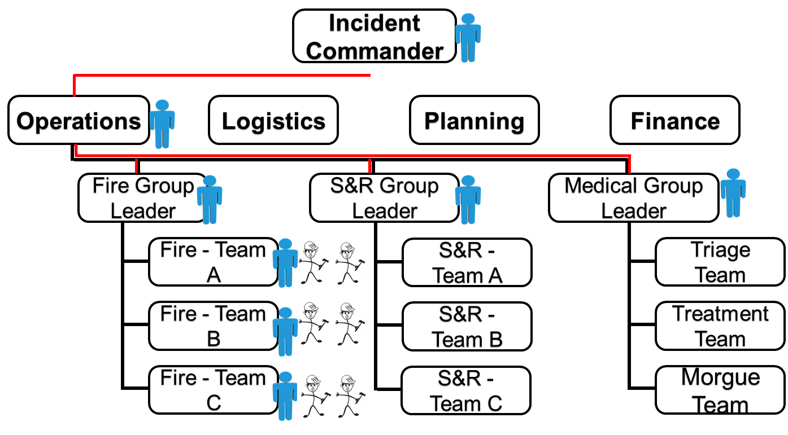
E.g. of Span of Control (how many people report to one person) 3 to 7 reports - Operations
S&R= Search and Rescue

Slide 12
CERT Mobilization
Take care of yourselves, your families, homes, and neighbors
Proceed to predesignated staging area
Establish Incident Command, organize the team
Collect info; sign in resources; Document!
Develop Action Plan; Deploy Resources
Organization evolves based on new information & resources
Notes:
11
1 - Make sure everything @ home is ok before you respond to the command post.
2 - Develop a plan as a group and then follow that plan, or Standard Operating Procedure (SOP).
3 - MAKE SURE that Incident Command is established immediately!
4 - Immediately begin to collect, document and prioritize incidents within your response area. Make sure that all the structures or target hazards in your area are checked, cleared and documented.
5 - Once you have identified the priorities, assign responders with appropriate training to mitigate the situation(s).
6 - Deploy your response teams, document who is going, to where, to do what and when and how you will communicate with them.

Slide 13
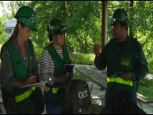
CERT in Action Video
Notes:
12
Start at 1:50 Go to 8:00
19 min total video

Slide 14
Break!
10 minutes
Notes:
13
CP = command staff

Slide 15
Documentation
Write
it down!
Notes:
14

Slide 16
Documentation
Section Chiefs (Ops, Planning, Logistics)
  Provide Command Post with information
Command Post
  Document the situation status
    Incident locations
    Access routes (teams into the neighborhood)
    Identified hazards (downed wires)
    Support locations (med treatment area(s))
IC Report Status to Professional Responders:
  Fire, Police, Medical, Public Health, Office of Emergency Services
Notes:
15
CP = command staff

Slide 17

Documentation
If it wasn’t written down
Write
it down!
It didn’t happen
Notes:
16

Slide 18
CERT ICS Documentation: Forms
Damage Assessment (CERT Form #1)
Personnel Resources Sign-In (CERT Form #2)
Incident/Assignment Tracking Log (CERT Form #3)
Briefing Assignment (Instructions to Team) (CF #4)
Victim Treatment Area Record (CERT Form #5)
Communications Log (CERT Form #6; ICS 309)
Equipment Inventory (CERT Form #7; ICS 303)
General Message (CERT Form #8; ICS 213)
Pad of paper (“CERT Form 0”)
Notes:
17
LA-CERT; pad and pen

Slide 19
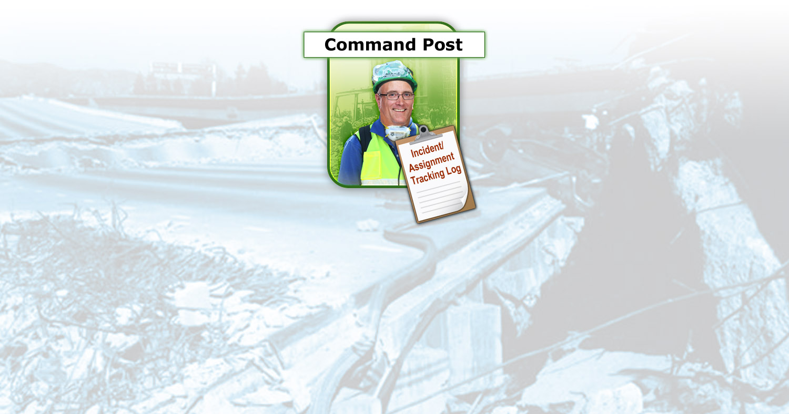
Documentation Flow
First person to arrive is Incident Commander
Doesn’t have to remain IC depending on who arrives later
Notes:
18

Slide 20
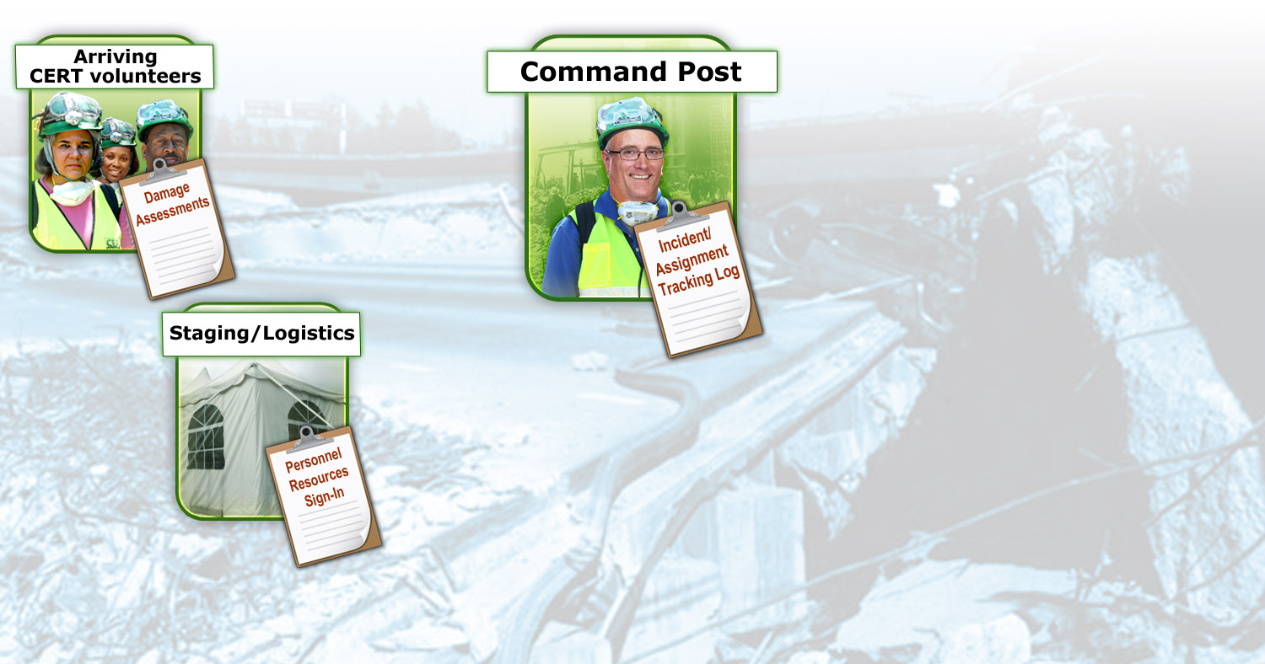
Initiation of CERT Organization
Planning
CERT Members arrive
Sign-in!
IC assigns Section Chiefs:
Operations, Logistics, Planning
Damage Assessments Gathered (or DA teams formed)
Notes:
19
Completed by CERT members as they travel through the area to the CERT staging location, then given to the CERT IC/TL; provides a summary of overall hazards in selected areas, including:
Fires; Utility hazards; Structural damage; Injuries and casualties; Available access
Essential for prioritizing and formulating action plans.
IC makes vol assignments
Personnel Resources-Used to sign in CERT members as they arrive at the staging location; provides information about:
Who is on site; When they arrived; When they were assigned; Their special skills
Used by staging personnel to track personnel availability
Incident Assignment Tracking Log-Used by the Command Post for keeping abreast of situation status; contains essential information for tracking the overall situation

Slide 21
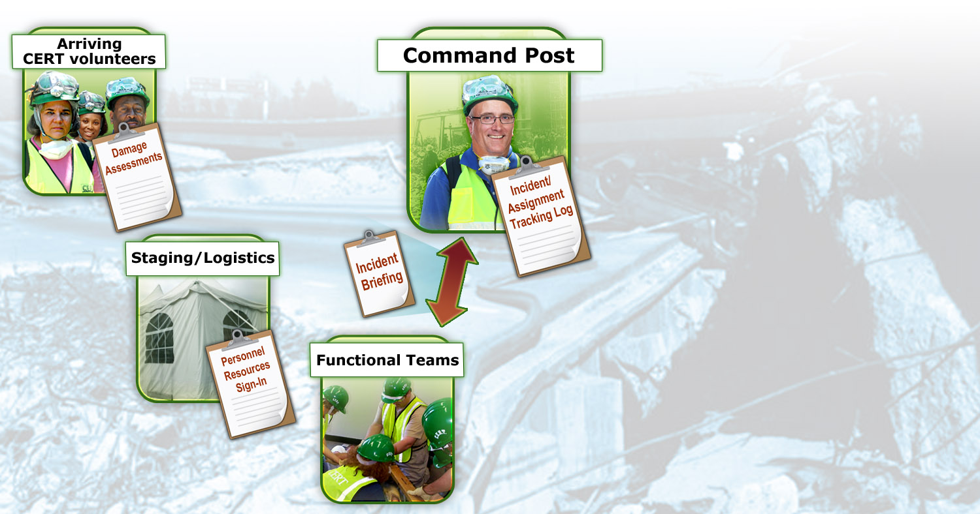

Briefing by IC, Team Assignments
Operational Teams Set up:
- Damage Assessment
- Medical
- Search and Rescue
- Fire Suppression
Planning
Briefing
Assignmt
Ops Teams
Notes:
20
Incident Assigment/Tracking Log-Used by the Command Post to provide instructions to functional teams; used by teams to log their actions and report new damage assessment information

Slide 22
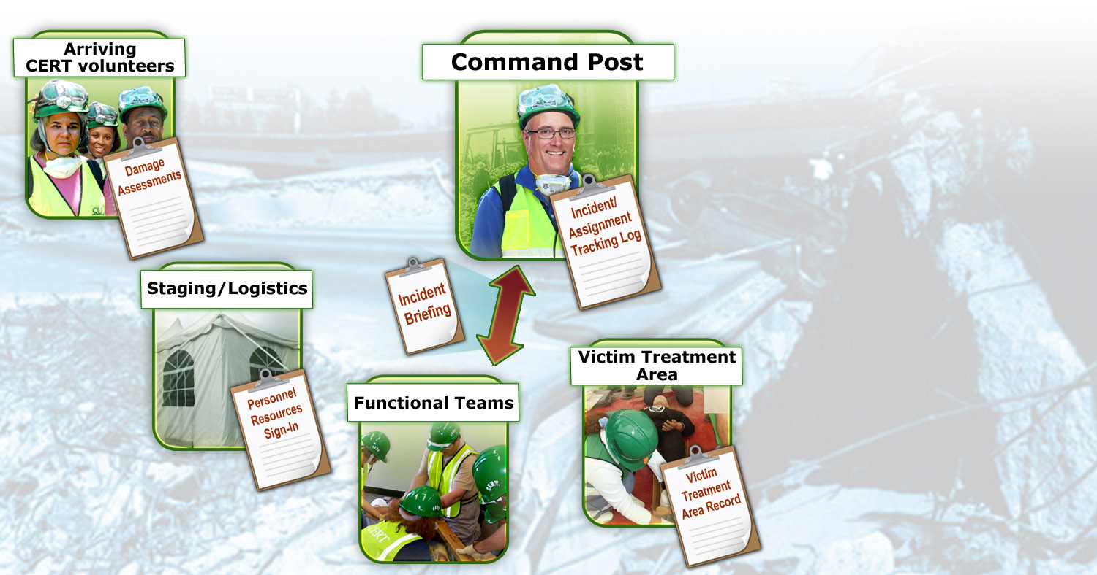

Medical: Record Victims & Treatment
Ready to receive and triage
Planning
Medical Operations
Ops Teams
Notes:
21
VTA Record-Completed by medical treatment area personnel to record victims entering the treatment area, their condition, and their status

Slide 23
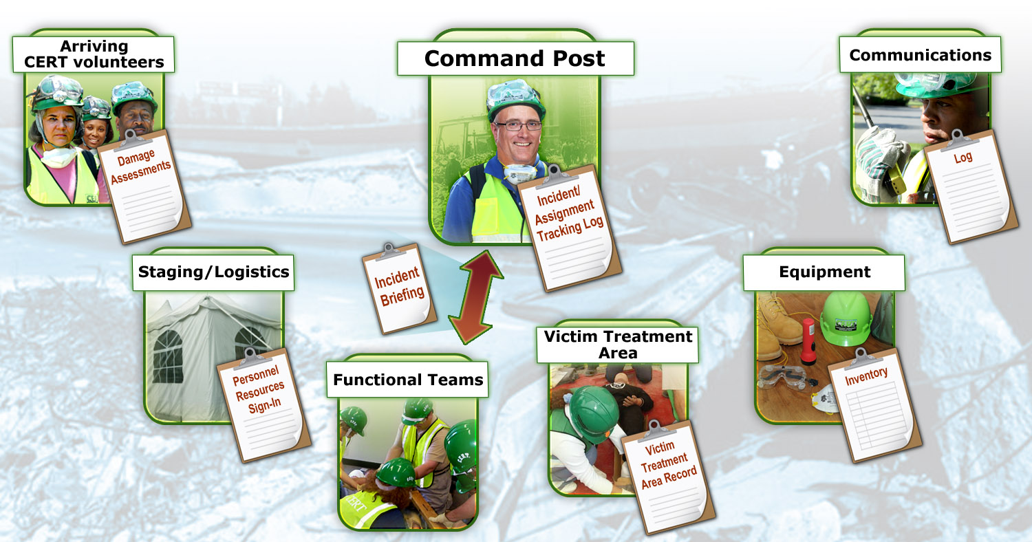

Logistics: Equipment/Supplies/Facilities
Scribe
Planning
Logistics
Medical Operations
Ops Teams
Ready to deploy
Notes:
22
Comm Log-Completed by the radio operator; used to log incoming and outgoing transmissions
Equipt Inventory-Used to check out and check in CERT-managed equipment

Slide 24
Tabletop Exercise!
Locate and set up your Incident Command Post (ICP)
Break into tables of 4 persons and assign roles:
  Incident Commander
  Operations Section Chief
  Communications Officer
  Scribe
Assume Logistics has provided all supplies & equipment
You will receive damage assessments during the exercise. You have to address them.
And SV means Spontaneous Volunteer: a walk-up
Notes:
23

Slide 25
Tabletop Role Descriptions
Incident Commander:
  Has overall responsibility for the neighborhood response. Maintains awareness of the situation. Decides what to do and when to do it. Is Safety Officer if no other has been designated.
Operations:
  Responsible to organize volunteers into field teams based on skills. Forms teams and knows where the volunteers are at all times. Map.
Communications:
  Conduit between IC and field teams; passes written and oral messages. Keeps Communications Log.
Scribe:
  Maintains Incident Status Board. Status Board info will be given to IC to report.
Notes:
24
Read Scenario, including Damage Assessment
Start Exercise
20 minutes, then Debrief

Slide 26
Tabletop “Rules”
IC may ask for advice from the Command Team, but IC is the only one to make decisions.
Don’t second-guess your IC.
You are to work only with the information given you.
Safety first
Greatest good for the greatest number
Save questions for the debriefing
Have fun!
Notes:
25

Slide 27
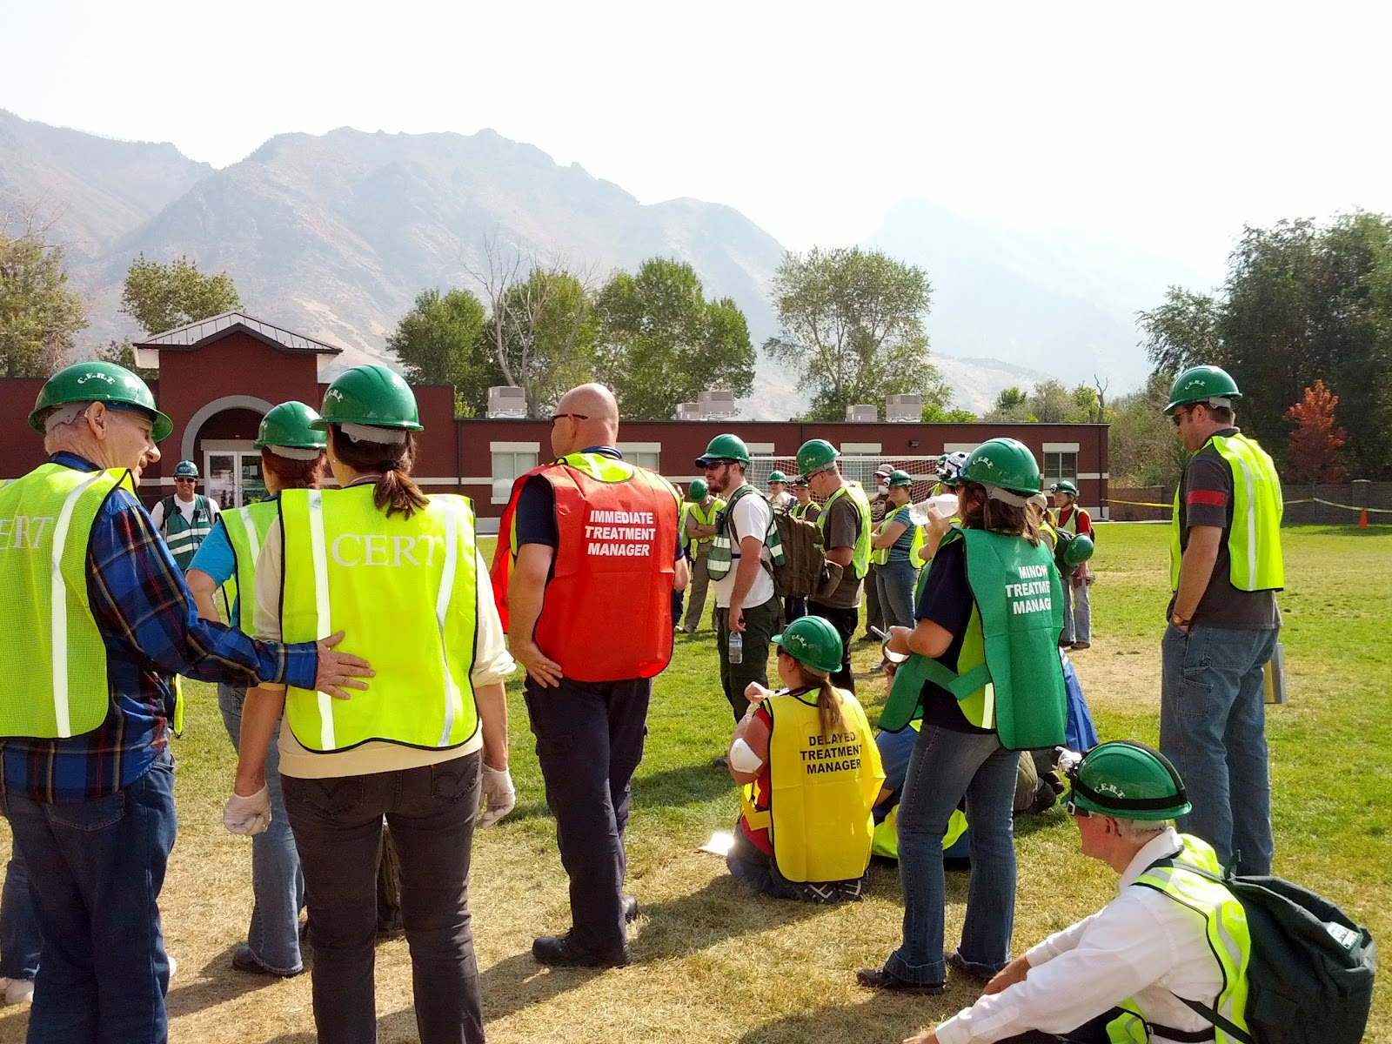
Tabletop Debrief
Notes:
26
Debrief Prompts

Slide 28
Summary
ICS provides flexible means of organization
“Is it safe for team members?”
Document and communicate information to all CERT levels
Provide Command Post with ongoing information about damage assessment, group status, and needs
Command Post documents and tracks situation status
Notes:
27

Slide 29
Basics of Establishing Your Neighborhood ICS
Intro to the Incident Command System: ICS-100b and ICS-200b
https://training.fema.gov/is/courseoverview.aspx?code=IS-100.b
https://training.fema.gov/is/courseoverview.aspx?code=IS-200.b
Other free FEMA on-line training courses
https://training.fema.gov/is/crslist.aspx?all=true
Apps for Alerts and Notifications
https://www.cityofberkeley.info/ACAlert/
http://www.nixle.com/
Notes:
28

